Slide 1

MTN-028
Study Product Considerations
Cindy Jacobson
Lindsay Kramzer
Microbicide Trials Network

Slide 2
Overview
Prescription Completion
Intravaginal Ring Supply and Labels
Chain of Custody
Intravaginal Ring Request Slip Completion
Used versus Unused Intravaginal Ring Return Processes
Study Product Complaints

Slide 3
Reference Materials
MTN-028 Protocol, Version 1.0
  Section 6
MTN-028 SSP
  Section 7
Site-Specific Clinic Study Product Accountability and Destruction SOP (non-pharmacy) for MTN-028

Slide 4
Study Product Regimen
One IVR will be inserted into the participant’s vagina at:
  Enrollment Visit (Visit 2)
Each participant is anticipated to use one IVR for a duration of approximately 28 days

Slide 5
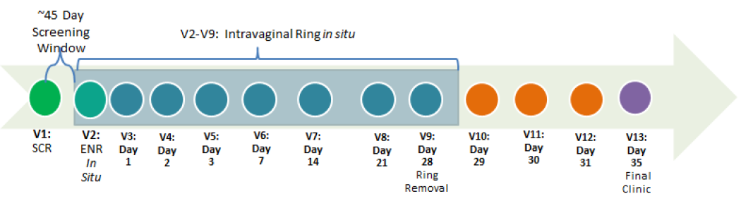
Study Visit Schedule

Slide 6
Study Randomization
  Participants will be randomized in a 2:1 ratio
N | Arm
12 | Low Dose MK-2048A IVR: VCV (MK-4176) 91mg + MK-2048 10mg
6 | Original Dose MK-2048A IVR: VCV (MK-4176) 182mg + MK-2048 30mg

Slide 7
Enrollment Visit
Randomization to study product occurs at the Enrollment Visit
Participant randomization will be conducted via the Frontier Science & Technology Research Foundation, Inc. (FSTRF) web-based system
Once a clinic staff member submits required participant info for enrollment/randomization, designated clinic and pharmacy staff will receive FSTRF randomization confirmation notice via email

Slide 8
Enrollment Visit
Prescription will be completed at Enrollment Visit
  2 part no carbon required (NCR) paper document.
  The top white is the original (pharmacy).
  The bottom yellow is the copy (clinic).
Prescriptions are provided to clinic staff by MTN LOC Pharmacy.

Slide 9
Enrollment Visit
Randomize participant via the online FSTRF system.
Print participant’s randomization confirmation notice and save.
Complete the participant’s prescription.
Fax the prescription (top white) and randomization confirmation notice to the pharmacy.
Once a week, send all original prescriptions (top white) and corresponding copies of the randomization confirmation notices to the pharmacy.

Slide 10
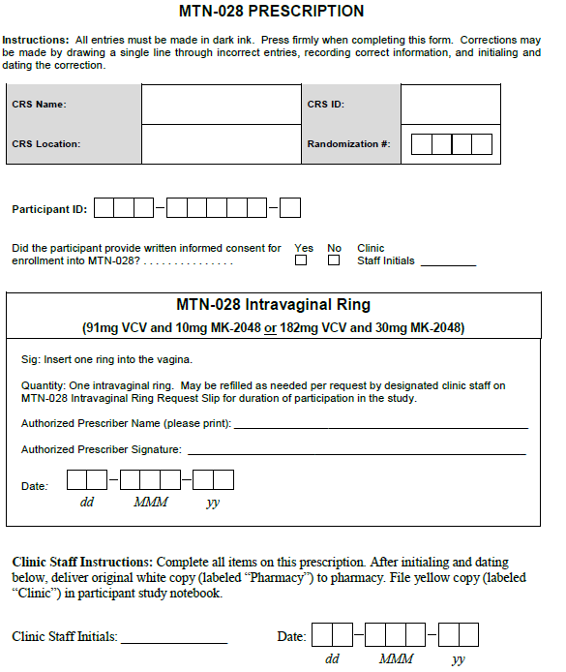

Slide 11
MTN-028 Prescription
To Be Completed by Clinic Staff:
CRS Name, CRS ID, CRS Location, Randomization #, Participant ID (PTID)
Indication of participant provision of informed consent/Clinic Staff Initials
Authorized Prescriber Name (FDA 1572), Signature, and Date
Clinic Staff Initials and Date (below Clinic Staff Instructions)

Slide 12
MTN-028 Prescription
Double check the accuracy of all entries
Errors may be corrected in blue or black ink by putting a line through and initialing
Retain the yellow copy for the participant study notebook in the clinic
Fax and Deliver white copy to pharmacy

Slide 13
MTN-028 Prescription
The pharmacist will review the prescription.
If an error is noted, the white and yellow copies must be individually corrected by an authorized prescriber with identical information on both copies.
If no problems are noted, the pharmacist will dispense the study product.

Slide 14
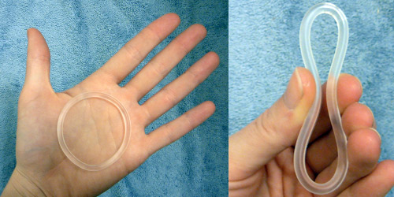
MTN-028 Study Product – Intravaginal Ring
Study Product
Two IVRs: Low Dose MK-2048A IVR: VCV (MK-4176) 91mg + MK-2048 10mg Original Dose MK-2048A IVR: VCV (MK-4176) 182mg + MK-2048 30mg
Overall, like NuvaRing
Smooth, flexible
Outer diameter: 54mm
Cross sectional diameter: 4mm
HOWEVER, MTN-028 IVRS are
White to off-white, opaque
  Original Dose > Low Dose

Slide 15
MTN-028 Study Product – Intravaginal Ring
Vicriviroc (VCV; MK-4176)
  CCR5 Inhibitor
MK-2048
  Integrase Inhibitor
MK-2048A
  Term for the combination IVR

Slide 16
Vicriviroc (VCV; MK-4176)
VCV (MK-4176) is a CYP3A4 substrate
  Extensively metabolized by CYP3A4
Participants must be counseled to avoid certain scheduled/routine CYP3A4 inhibitors and inducers via any route of administration
Refer to SSP Section 7.7
  Appendices 7-3 and 7-4
Note: Single dose oral fluconazole is permitted.
If you have further questions, please contact the MTN-028 PSRT (mtn028psrt@mtnstopshiv.org).

Slide 17
MTN-028 Study Product – Intravaginal Ring
IVRs are individually wrapped (overwrap pouch) and labeled
IVRs consist of a closed-ring fiber having two layers: core and skin.
  Core layer contains VCV
  Skin layer contains MK-2048
  Both drugs are dispersed in ethylene vinyl acetate (EVA) copolymer
IVR is designed to provide sustained release of drug over 28-day period

Slide 18
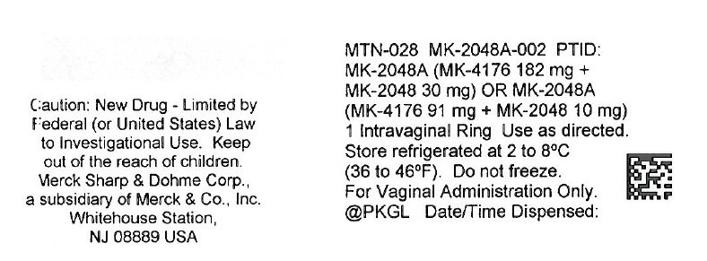
MTN-028 IVR Pouch Label
PoR will indicate PTID and dispensation date/time prior to dispensing IVR

Slide 19
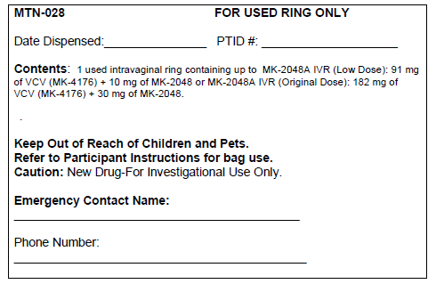
MTN-028 Returned Used IVR Label (on white bag)
PoR to indicate
Clinic Staff to indicate

Slide 20
Chain Of Custody
The study product must be tracked with documentation, from the pharmacy to the participant and all steps in between.
Study product (one IVR) may be prepared and dispensed by the pharmacist based on either original documents or faxed copies.

Slide 21
Chain Of Custody
Study Product is dispensed by pharmacy staff to:
  Clinic staff who will then deliver the IVR to the participant
  To courier/runner who delivers the IVR to clinic staff who will then provide the IVR to the participant
  Depends on pharmacy site-specific Chain of Custody SOP
Chain of Custody from pharmacy staff to courier is documented on the MTN-028 Delivery Documentation Form at time of IVR dispensation
Notes:
MTN-028 Delivery Documentation Form is used at this site instead of the MTN-028 Record of Receipt of Site-Specific Vaginal Rings

Slide 22
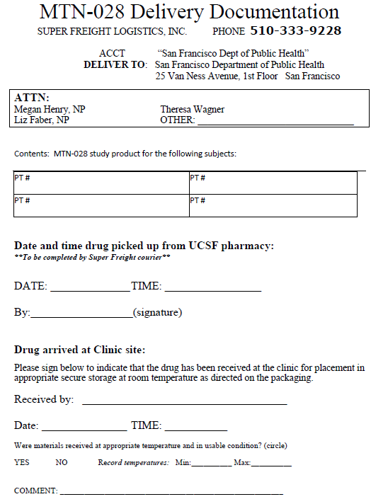
MTN-028 Delivery Documentation Form

Slide 23
Chain of Custody
Clinic Staff Responsibilities
Control access to the IVRs in clinic staff custody
Clinic staff must document delivery of the IVR to the designated participant on the Participant-Specific Clinic Study Product Accountability Log

Slide 24
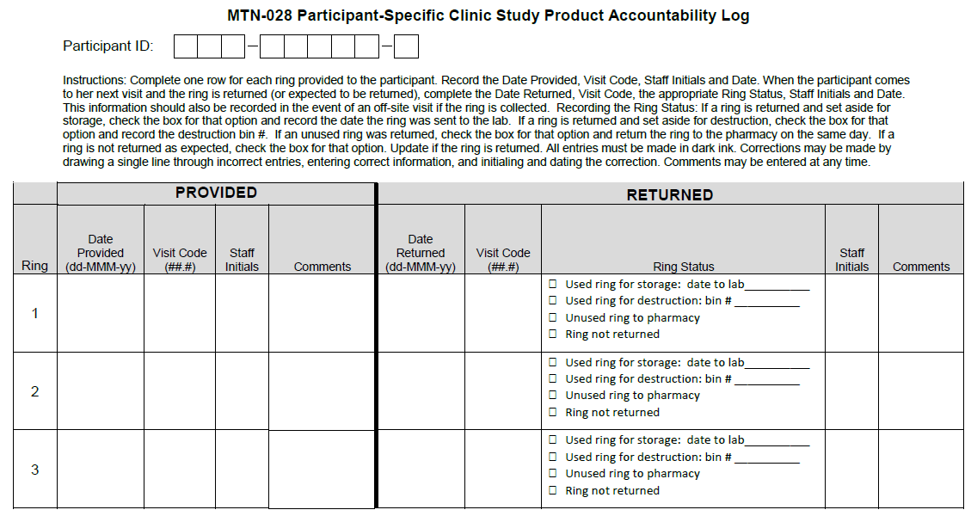

Slide 25
Chain of Custody
Clinic Staff Responsibilities
If an IVR dispensed for a participant is not provided to the participant, clinic staff must document this in the participant's study chart and return the unused IVR to the pharmacy as soon as participant’s visit is completed.

Slide 26
Study Visit Schedule
It is anticipated that each participant will only need one IVR for the duration of study participation.

Slide 27
Dispensing IVR during Follow-Up
Scheduled follow-up visits, as needed
Interim visits, as needed
Clinic Staff will indicate RE-SUPPLY on an MTN-027 Intravaginal Ring Request Slip
  Request Slip is a 2 part no carbon required (NCR) paper document. The top white is the original (pharmacy) and the bottom is yellow (clinic).
Request Slips are provided to clinic staff by MTN LOC Pharmacy.

Slide 28
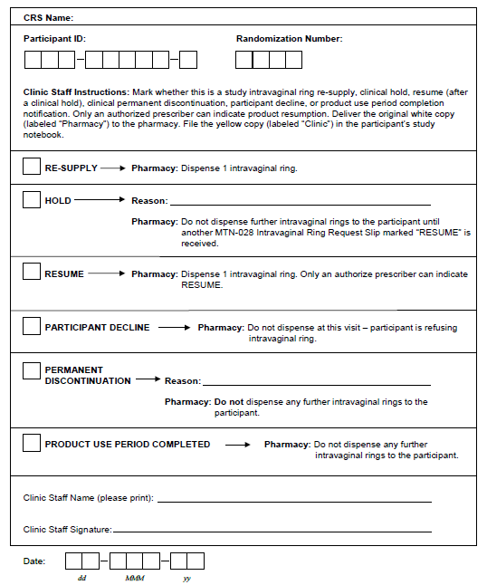
MTN-028 Intravaginal Ring Request Slip
Notes:
Study Product Re-supply
At scheduled mid study period visit or for other reason (indicate reason)
Study Product Hold (Clinically indicated)
Indicate reason
Study Product Resume
Study Product Permanent Discontinuation
Indicate reason
Participant Decline
Participant No Longer In Study

Slide 29
IVR Request Slip Completion
This slip can be completed by any authorized clinic staff except in the case of indicating “RESUME”
  Only authorized prescribers can indicate “RESUME”
Double check the accuracy of all entries
Errors may be corrected in blue or black ink by putting a line through and initialing
Retain the yellow copy for the participant study notebook in the clinic
  Fax and then deliver (batched) white copy to pharmacy
  Once the white and yellow copies are separated errors must be corrected on each sheet separately

Slide 30
IVR Request Slip Completion
RE-SUPPLY
  Used by clinic staff to communicate to pharmacist the study product quantity to be re-supplied to each participant at follow-up visits (scheduled and unscheduled/interim visits)
    One IVR
    Never more than one IVR

Slide 31
IVR RE-SUPPLY
At minimum, the following procedures must be conducted in order to dispense study product at follow-up:
  AE assessment and clinical management
    Protocol Section 8
  Pregnancy test and/or HIV test, if indicated/IoR discretion
    Must be negative prior to IVR re-supply
  Collection of used/unused IVR, if available
  Adherence Counseling/Vaginal Ring Use Instructions, as needed
Notes:
• AE assessment and clinical management, in accordance with section 8 of the protocol (verbal report of symptoms is acceptable; if symptoms indicate that further evaluation is necessary, this must be conducted prior to dispensing study product).
• If indicated based on clinical discretion (e.g. participant reports risk behaviors and/or shows signs/symptoms of HIV or pregnancy), a pregnancy test and/or HIV testing may be performed and must be negative prior to dispensing study product.
• Collection of used vaginal ring (and unused, if applicable), if available.
• Adherence Counseling/Vaginal Ring Use Instructions, as needed.

Slide 32
MTN-028 Intravaginal Ring Request Slip
Notes:
Study Product Re-supply
At scheduled mid study period visit or for other reason (indicate reason)
Study Product Hold (Clinically indicated)
Indicate reason
Study Product Resume
Study Product Permanent Discontinuation
Indicate reason
Participant Decline
Participant No Longer In Study

Slide 33
IVR Request Slip Completion
HOLD
  Used by clinic staff to communicate to pharmacist that the participant has a temporary IVR hold due to a clinical/safety reason(s)
  Record reason for hold

Slide 34
IVR Request Slip Completion
RESUME
  Once a product hold is in effect, the pharmacist will not dispense any study product to that participant until a subsequent request slip is received and “RESUME” is marked on that request slip
    One IVR
  Only an authorized prescriber indicated on the FDA 1572 form can initiate a VR resume

Slide 35
IVR Request Slip Completion
PARTICIPANT DECLINE
  If a participant decides that she does not want to use the IVR, then the box for “PARTICIPANT DECLINE” is marked
  This is not a clinical hold and does not require a “RESUME’
  When the participant wants to continue product, the clinic staff will complete a new request slip for RE-SUPPLY
    One IVR

Slide 36
IVR Request Slip Completion
PERMANENT DISCONTINUATION
  If study clinician determines that a participant should permanently stop IVR use due to safety reason(s), then the box for “PERMANENT DISCONTINUATION” is marked
  Indicate reason for permanent discontinuation
  Future IVR request slips will no longer be completed at the participant’s remaining study visits

Slide 37
IVR Request Slip Completion
PRODUCT USE PERIOD COMPLETED
  Used by clinic staff to communicate to the pharmacy when the participant has completed or withdrawn from the study

Slide 38
IVR Request Slip
At minimum, the Request Slip should be used for:
  One scheduled Product Use Period Completed
  Day 28, Visit 9

Slide 39
Retrieval of IVR
Review protocol section 6.4.4 for guidelines regarding ring retrieval following discontinuation, hold and Final Clinic Visit
Document all efforts to retrieve study product in chart notes, if study product is not returned by the participant

Slide 40
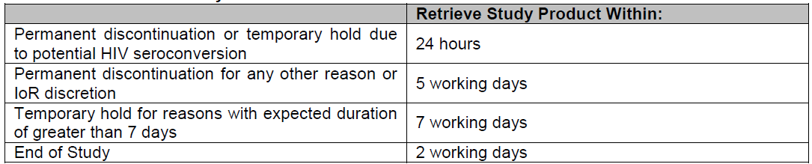
Retrieval of IVR
If not retrieved within timeframe stated above, the MTN-028 PSRT must be informed. All attempts to retrieve product should be documented.

Slide 41
Retrieval of IVR
It is not necessary to retrieve IVR from participant for whom IVR use is being temporarily held for less than 7 days. However, IVR can be retrieved to protect participant’s safety (IoR discretion).
All IVRs remaining in the participants possession should be retrieved at/by Visit 9/Day 28. If the participant does not bring the ring back at this visit, clinic staff need to arrange to retrieve the ring within 2 business days. If the IVR is not retrieved within that timeframe, the MTN-028 PSRT must be informed.

Slide 42
Retrieval of IVR
IVR retrieval may occur by the participant returning the IVR to study staff within the specified timeframe or attempts should be made by study staff to contact the participant to retrieve IVR as soon as possible
  Always document retrieval efforts

Slide 43
USED Vaginal Ring Return/Destruction
Follow your Site-Specific Clinic Study Product Accountability and Destruction SOP (non-pharmacy) for MTN-028
  Participant-Specific Clinic Study Product Accountability Log
  Clinic Study Product Destruction Log
    Expect this to be very rare

Slide 45
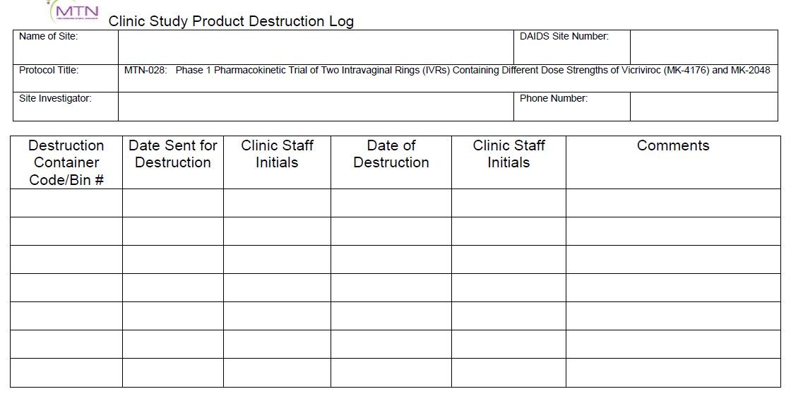

Slide 46
Unused Vaginal Ring Return
ONLY unused study product should be returned to the pharmacy
  NO USED IVRs should be returned to the pharmacy
  Used IVRs will be forwarded to lab or for destruction
Unused IVR is returned to the pharmacy by:
  Clinic staff member or courier/runner
  Depends on pharmacy site-specific Chain of Custody SOP
Documented on Record of Return of Site-Specific Unused Intravaginal Rings
  This record is stored in the pharmacy
Notes:
In response to last bullet point, damaged unused study product should be counted as returned.

Slide 47
Chain Of Custody
If returning unused IVR because damaged or contaminated, record the details on the record
The pharmacy will document and quarantine any returned unused IVRs

Slide 48
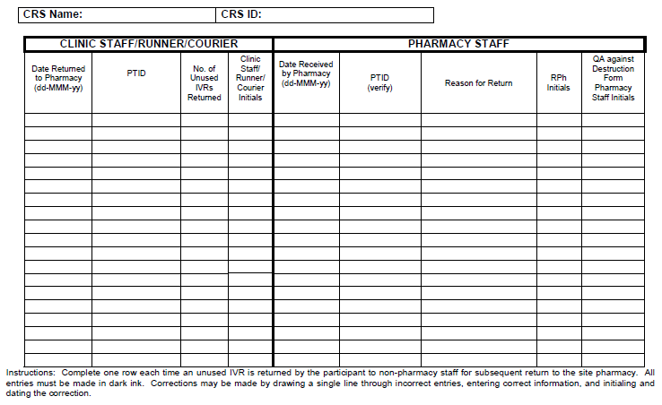
MTN-028 Record of Return of Unused Site-Specific Intravaginal Rings

Slide 49
Study Product Complaints
Study product problem may be noted by pharmacy, clinic, and/or participant.
  May concern dosage form (IVR), packaging (overwrap), or other aspect.
Clinic staff will make thorough record of clinic staff or participant complaint.
Clinic staff member will email complaint to pharmacy.
  Date of observed issue, date issue was reported, date IVR was dispensed, did adverse event occur, nature of issue, picture (if possible and applicable), any other necessary details

Slide 50
Study Product Complaints
Pharmacy staff will email all study product complaints to MTN LOC Pharmacy.
MTN LOC Pharmacy will forward complaints to Merck to be submitted to the Merck Internal Complaint Process.
If the complaint is concerning an unused IVR, then the unused IVR should be held in quarantine in the pharmacy.
If the complaint is concerning a used IVR, then the clinic staff should process the IVR per standard operating procedures for used IVRs.

Slide 51
Supplies Provided
MTN LOC Pharmacist will ship
(No order necessary)
To Pharmacy:
30 Labeled Used IVR Return Bags (white)
35 Participant-Specific Pharmacy Dispensing Records
To Clinic:
35 Prescriptions
50 Intravaginal Ring Request Slips
1 Case of Male Condoms
5 Sample Intravaginal Rings (Demonstration ONLY)

Slide 52
Contact Information
If you have any questions, please do not hesitate to contact us:
Cindy Jacobson
(412) 641-8913
cjacobson@upmc.edu
Lindsay Kramzer
(412) 641-3865
fergusonlm@upmc.edu

Slide 53

Thank You!

